Slide 1
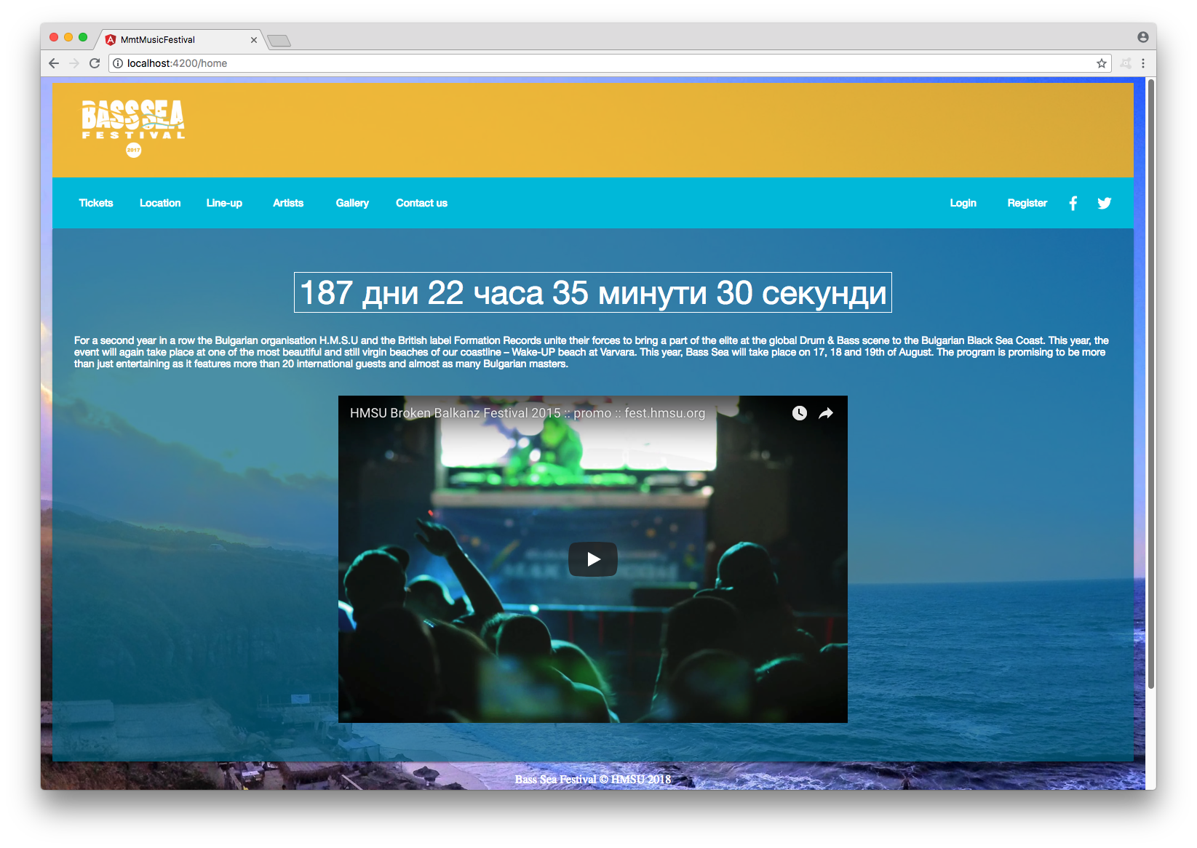
Music festival app
Building a page for Bulgarian open-air music festival
Angular 5
HTML 5
CSS
Node.js
Express
Angular
Material
Geolocation:
Google Maps
Video:
YouTube
Audio:
SoundCloud
MixCloud
Home screen
Изготвен от: Кристиана Ал-Атаси ф.н. 44714 и Станимир Мирчев ф.н. 44908

Slide 2
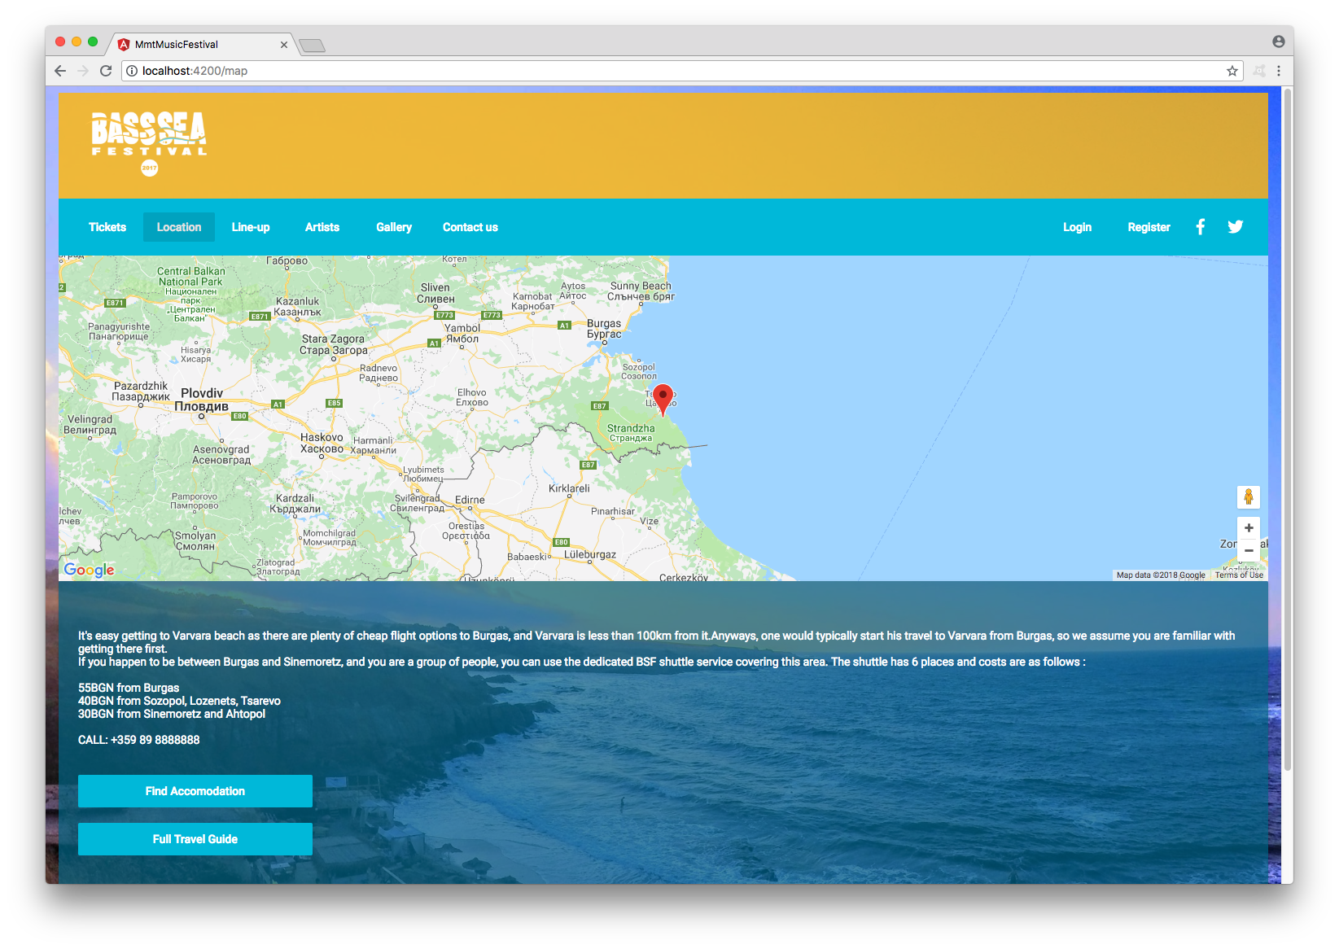

Slide 3
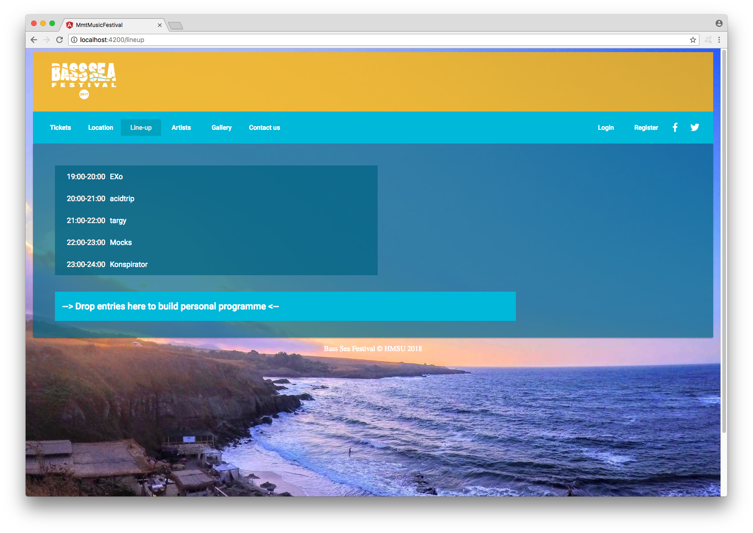

Slide 4
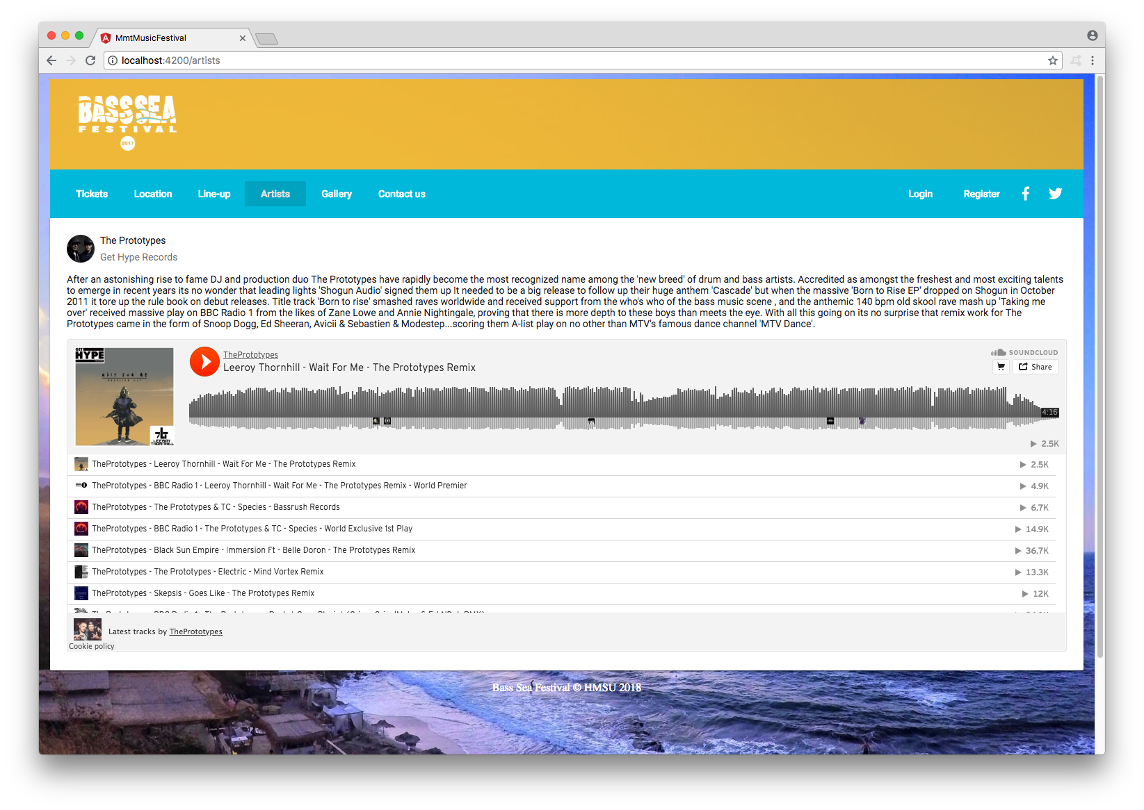

Slide 5
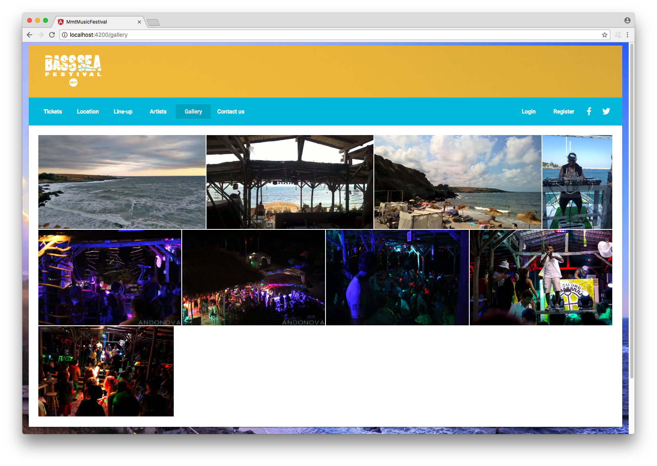

Slide 6
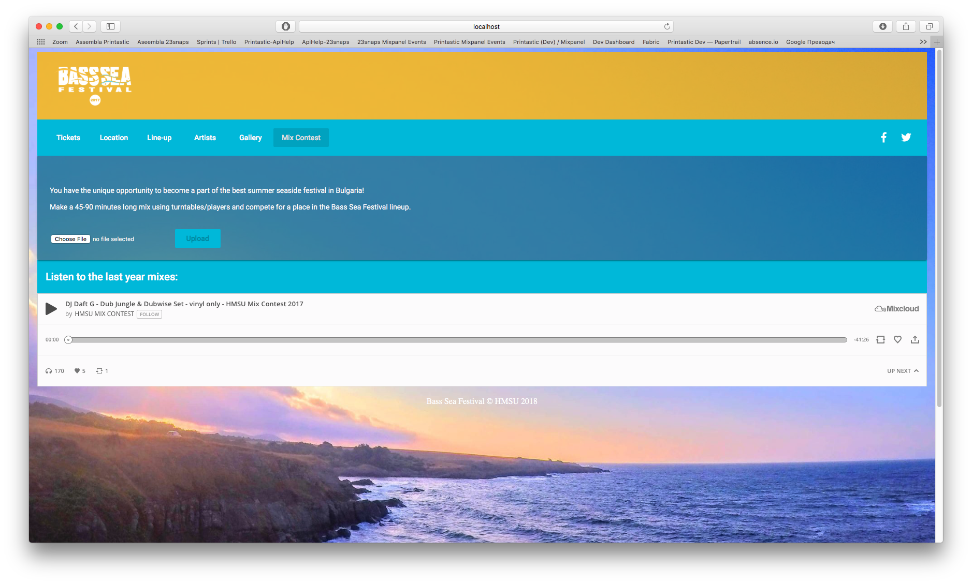

Slide 7
